Slide 1

TECHNGLOBAL PRIVATE LIMITED
8-Bit Arithmetic Logic Unit (ALU)
Design & Implementation using Verilog HDL
Submitted by: Aryan Singh Branch: Electronics & Communication Engineering Institute: Maulana Azad National Institute of Technology, Bhopal Internship: VLSI Design — TechnGlobal Industrial Training Program | May - June 2026
GitHub Repository: github.com/AryanASingh/verilog-hdl-alu-project

Slide 2
Table of Contents
Project Documentation Overview
01
Project Overview & Objectives
06
Simulation Waveform Results
02
ALU Architecture & Operations
07
Power & Implementation Reports
03
Verilog HDL Design Implementation
08
DRC Report & Design Verification
04
Testbench & Simulation
09
Conclusion & Future Scope
05
RTL Schematic & Synthesis
8-Bit ALU | Aryan Singh | ECE | MANIT Bhopal | TechGlobal VLSI Internship

Slide 3
Project Overview & Objectives
Minor Project — VLSI Domain
What is an ALU?
An Arithmetic Logic Unit (ALU) is the core computational component of any processor. It performs arithmetic and logical operations on binary data. An 8-bit ALU processes operands that are 8 bits wide, making it a foundational building block in digital design and embedded systems.
Project Objectives
Design an 8-bit ALU supporting 8 distinct operations using Verilog HDL
Implement a modular, scalable architecture with separate sub-modules per operation
Verify functionality through comprehensive testbench simulation in Xilinx Vivado
Synthesize & implement on FPGA with power and timing analysis
Document RTL schematic, DRC reports, and implementation logs
8-Bit ALU | Aryan Singh | ECE | MANIT Bhopal | TechGlobal VLSI Internship

Slide 4
ALU Architecture & Signal Flow
Inputs, Operations, and Outputs
Port Specification
SEL Opcode Map
Port | Width | Direction | Description
A[7:0] | 8-bit | Input | Operand A
B[7:0] | 8-bit | Input | Operand B
carry_in | 1-bit | Input | Carry / Borrow input
SEL[2:0] | 3-bit | Input | Operation selector (opcode)
Result[7:0] | 8-bit | Output | Computed result
carry_out | 1-bit | Output | Carry / Borrow output
zero_flag | 1-bit | Output | High when Result = 0
SEL | Operation | Expression
3'b000 | ADD | A + B + Cin
3'b001 | SUB | A − B − Cin
3'b010 | AND | A & B
3'b011 | OR | A | B
3'b100 | XOR | A ^ B
3'b101 | NOT | ~A
3'b110 | SHL | A << 1
3'b111 | SHR | A >> 1
Flags: carry_out propagates MSB shift or arithmetic overflow. zero_flag asserts when Result == 8'b00000000.
8-Bit ALU | Aryan Singh | ECE | MANIT Bhopal | TechGlobal VLSI Internship

Slide 5
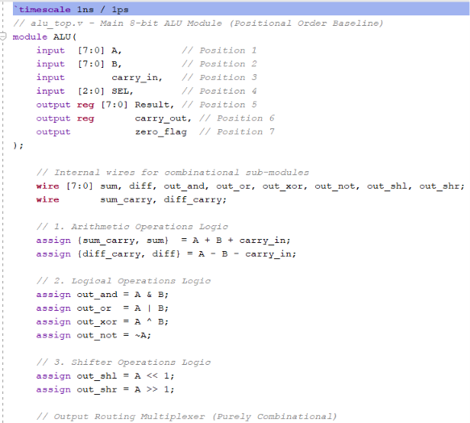
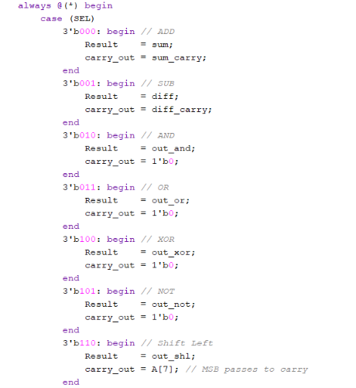
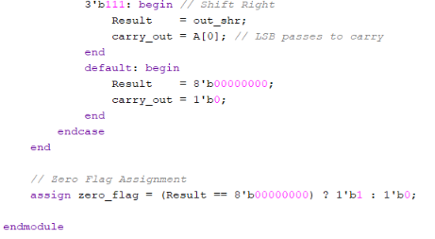
Verilog HDL Design — ALU.v
Full Source Code: Module Declaration, Logic Assignments & Case Statement
GitHub Repository: github.com/AryanASingh/verilog-hdl-alu-project
8-Bit ALU | Aryan Singh | ECE | MANIT Bhopal | TechGlobal VLSI Internship

Slide 6
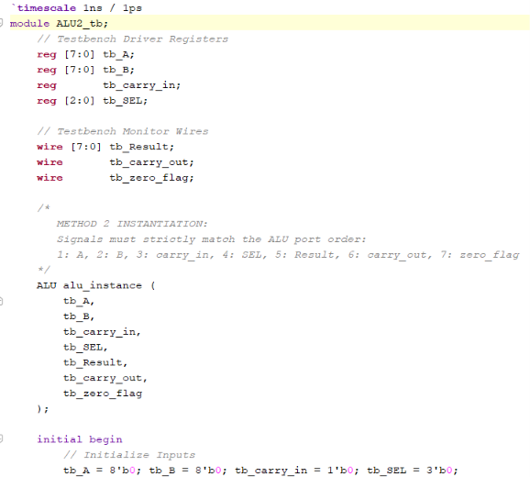
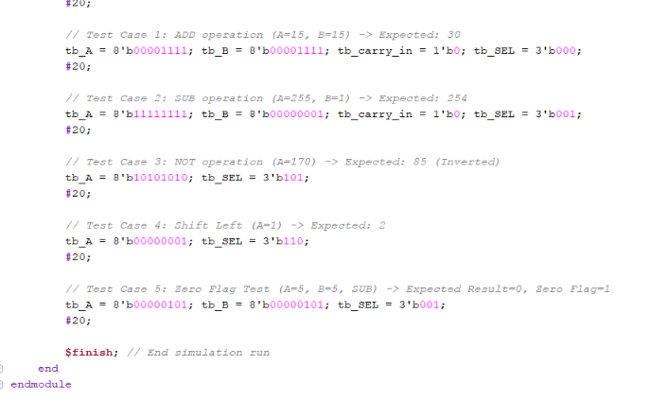
Testbench Design — ALU2_tb.v
Verification Code: Driver Registers, Instantiation & Test Vectors
GitHub Repository: github.com/AryanASingh/verilog-hdl-alu-project
8-Bit ALU | Aryan Singh | ECE | MANIT Bhopal | TechGlobal VLSI Internship

Slide 7
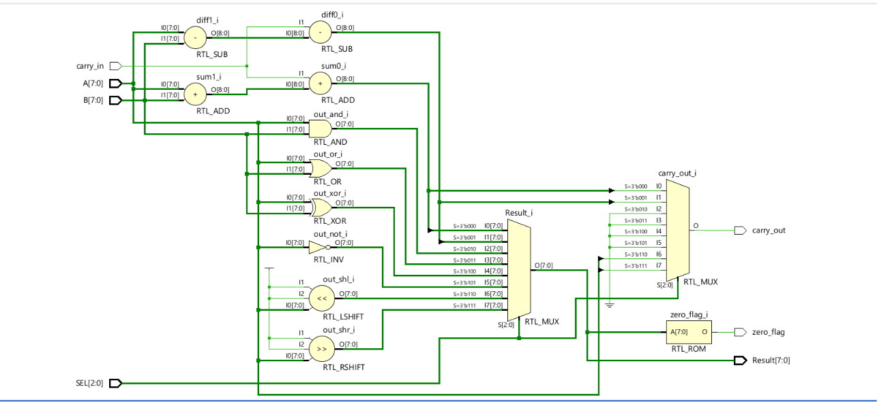
RTL Schematic — Xilinx Vivado
Synthesized Register Transfer Level view of the 8-bit ALU design
8-Bit ALU | Aryan Singh | ECE | MANIT Bhopal | RTL Schematic — Xilinx Vivado

Slide 8
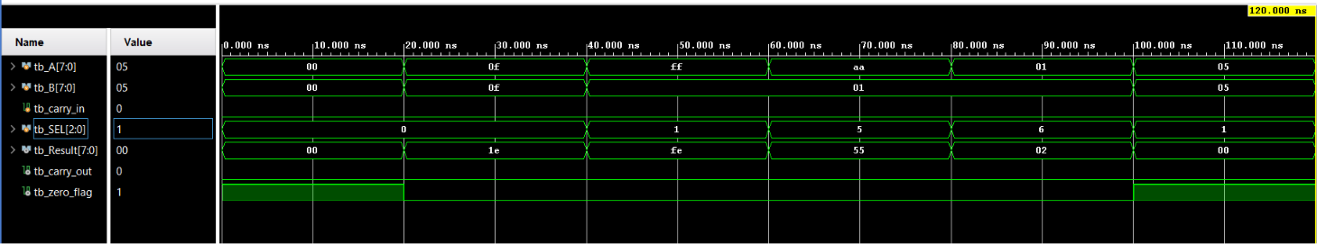
Simulation Waveform Results
All 8 operations verified — Xilinx Vivado Simulation (120 ns window)
INIT
00→00
ADD
0F+0F=1E
SUB
FF-01=FE
NOT
AA→55
SHL
01→02
SUB
Z=1
8-Bit ALU | Aryan Singh | ECE | MANIT Bhopal | Simulation Waveform Results

Slide 9
Waveform Analysis & Verification
Test Case Results — All 8 Operations
Op | SEL | A | B | Cin | Result | Cout | Zero | Status
ADD | 3'b000 | 0x0F | 0x0F | 0 | 0x1E | 0 | 0 | PASS
SUB | 3'b001 | 0xFF | 0x01 | 0 | 0xFE | 1 | 0 | PASS
NOT | 3'b101 | 0xAA | — | — | 0x55 | 0 | 0 | PASS
SHL | 3'b110 | 0x01 | — | — | 0x02 | 0 | 0 | PASS
SUB (Zero) | 3'b001 | 0x05 | 0x05 | 0 | 0x00 | 0 | 1 | PASS
Key Observations
All 5 tested operations produce correct results as per truth table analysis
Zero flag correctly asserts when 0x05 − 0x05 = 0x00 (Test Case 5)
Carry output correctly propagated for ADD and SUB operations
NOT operation correctly inverts only operand A (0xAA → 0x55)
SHL correctly shifts A left by 1 bit with MSB going to carry_out
8-Bit ALU | Aryan Singh | ECE | MANIT Bhopal | TechGlobal VLSI Internship

Slide 10
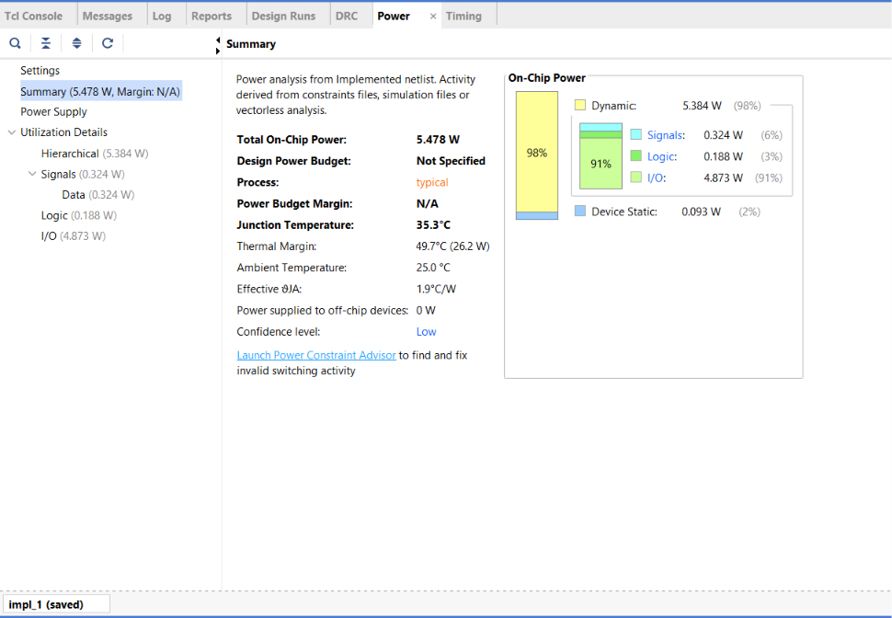
Power Analysis Report
Xilinx Vivado Power Estimation
Power Summary
Category | Value | Share
Total On-Chip | 5.478 W | 100%
Dynamic | 5.384 W | 98%
• Signals | 0.324 W | 6%
• Logic | 0.188 W | 3%
• I/O | 4.873 W | 91%
Device Static | 0.093 W | 2%
Thermal Notes Junction Temp: 35.3°C | Thermal Margin: 49.7°C
Confidence Level: Low (no XDC constraints)
8-Bit ALU | Aryan Singh | ECE | MANIT Bhopal | TechGlobal VLSI Internship

Slide 11
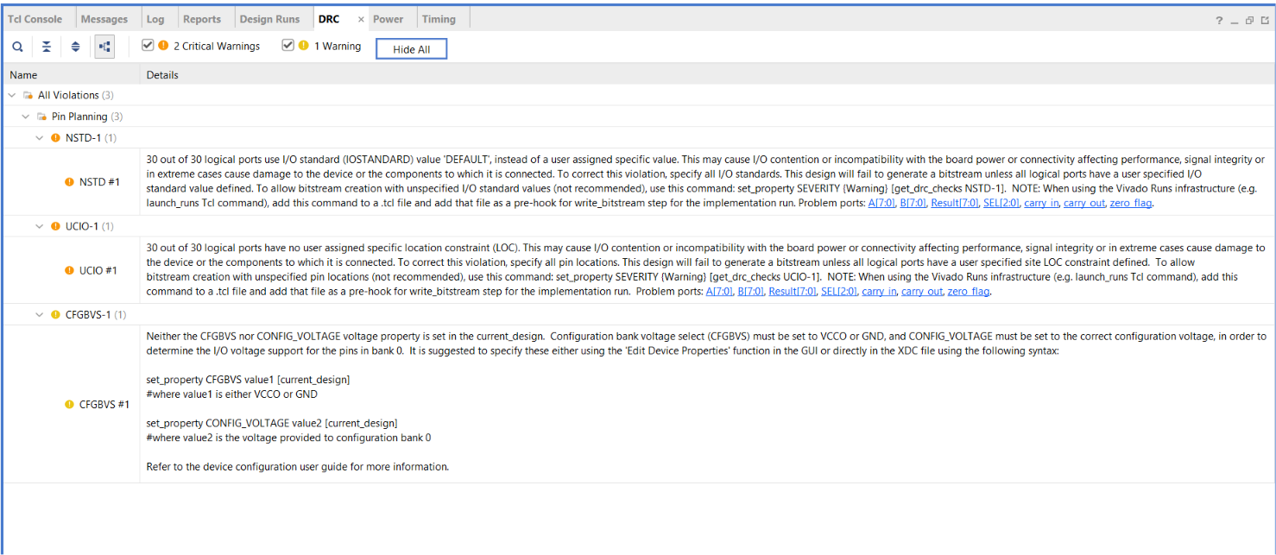
DRC Report & Design Rule Check
Design Violations & Resolution Path
DRC Violations Found
NSTD-1 — Critical
30 ports using DEFAULT IOSTANDARD (no XDC pin constraints assigned)
UCIO-1 — Critical
30 ports have no LOC constraint; pin location unspecified
CFGBVS-1 — Warning
CFGBVS / CONFIG_VOLTAGE not set for bank 0 configuration voltage
Resolution: Add a .xdc constraints file specifying IOSTANDARD, LOC, and CFGBVS properties for all 30 ports to generate a valid bitstream.
8-Bit ALU | Aryan Singh | ECE | MANIT Bhopal | TechGlobal VLSI Internship

Slide 12
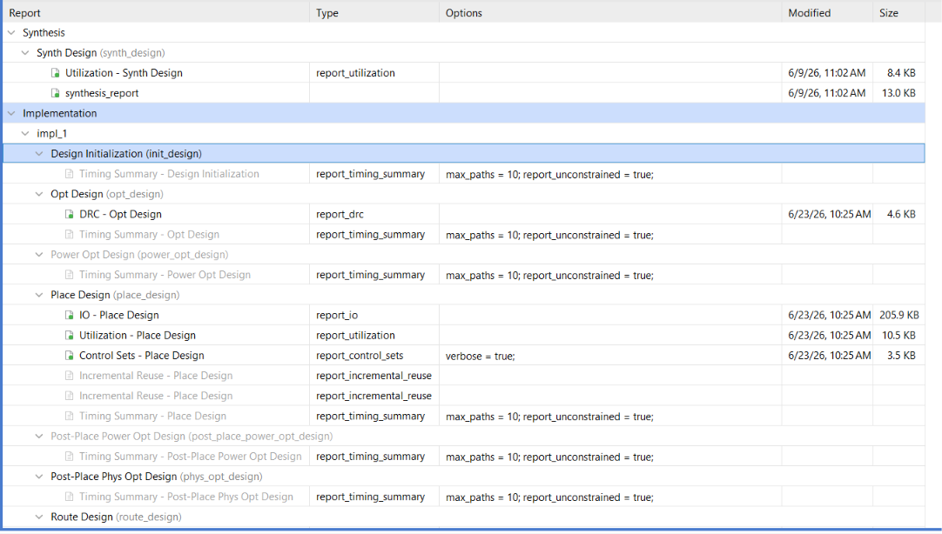
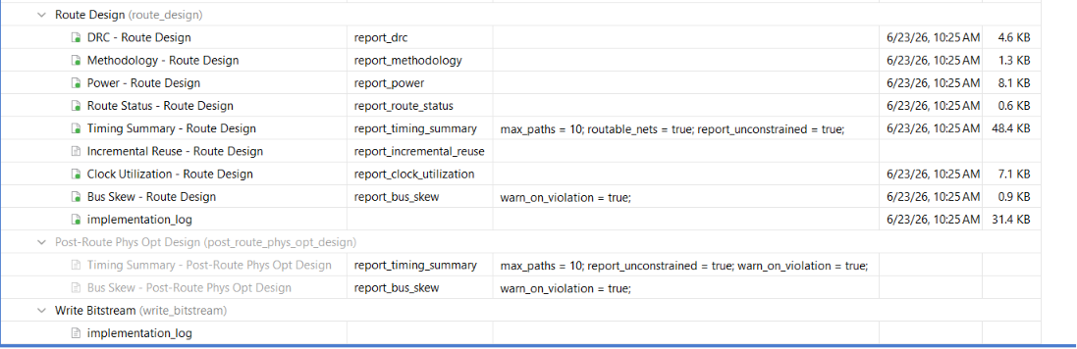
Implementation Reports — Vivado
Synthesis → Place → Route Pipeline
Synthesis: 6/9/26 11:02 AM | Implementation (Place+Route): 6/23/26 10:25 AM | All design stages completed successfully
8-Bit ALU | Aryan Singh | ECE | MANIT Bhopal | TechGlobal VLSI Internship

Slide 13
Conclusion & Future Scope
Achievements
Future Enhancements
Successfully designed 8-bit ALU with 8 operations
Add signed arithmetic (overflow detection)
Fully verified through Vivado simulation (all 5 test cases PASS)
Implement multiply and divide operations
RTL schematic, synthesis & implementation completed
Add XDC constraints for bitstream generation
Power analysis and DRC reports generated
FPGA deployment on Basys3 / Nexys board
Purely combinational design using always @(*)
Expand to 16-bit or 32-bit ALU for RISC core
"This project establishes a strong foundation for digital design, processor architecture, and FPGA implementation."

Slide 14
Thank You
Aryan Singh Electronics & Communication Engineering Maulana Azad National Institute of Technology, Bhopal VLSI Domain — Minor Project TechGlobal Industrial Training Program | June 2025
TECHNGLOBAL PRIVATE LIMITED | info@technglobal.in | www.technglobal.in

